Slide 1


Slide 2
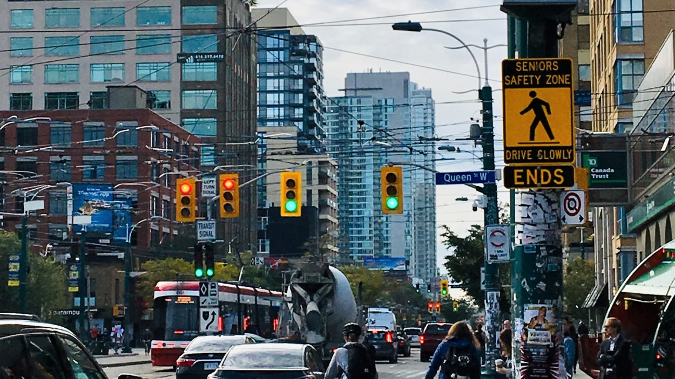

Slide 3
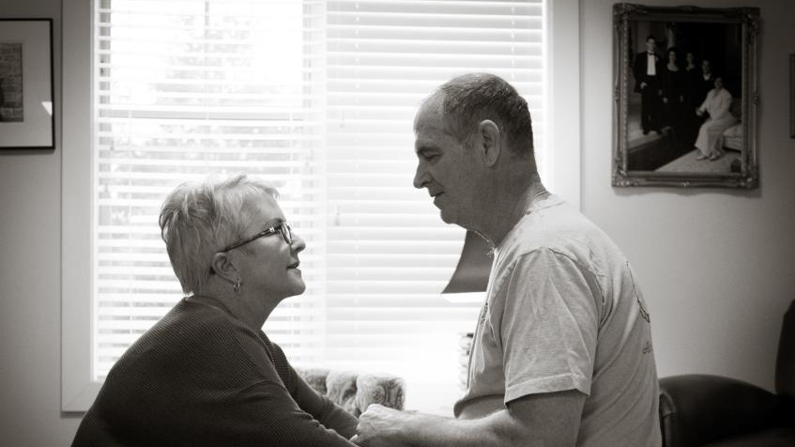

Slide 5




Blink
Empowering the Visually Impaired to See
Hack the 6ix 2023

Slide 6
Blink
Ask Follow-up Questions
Describe Your Surrounding
Analyze Text inside Images
See the World with AI

Slide 7
Development
Implementation
Risk Assessment
Evaluation
Blink

Slide 8
App
Demo

Slide 9
Blink
THANK YOU
Hack the 6ix 2023

